Slide 1
ICD-10-CM
An Introduction
Notes:
2009 Codes
The single most significant coding change in 30 years is before us – the conversion from ICD-9 to ICD-10
The change will impact virtually all facets of your clinical practice and research. Major changes will have to occur to our business processes and our information systems. Countless hours will need to be spent education our faculty and the vast majority of our staff.

Slide 2
BACKGROUND
International Classification of Diseases (ICD)
In the U.S., ICD-10 is split into two systems: ICD-10-CM (Clinical Modification) for diagnostic coding and ICD-10-PCS (Procedure Coding System) for inpatient hospital procedure coding.
It is a medical classification for disease, signs & symptoms, abnormal findings and social circumstances.
It is published by the World Health Organization (WHO)

Slide 3
Process of coding is similar
  Look up a condition in the Alphabetic Index
  Confirm the code in the Tabular List

Slide 4
ICD-10 FEATURES
ICD-10-CM codes are all alphanumeric
First character is always an alpha character
Subsequent characters may be alpha or numeric
Example:
  I82.a11 Acute embolism and thrombosis of right axillary vein
Codes may be 3, 4, 5, 6 or 7 characters in length

Slide 5
ICD-10-CM Structure – Format
Alpha
(Except U)
2 - 7 Numeric or Alpha
Additional Characters
.
.
X
X
X
X
A
A
M
S
X
3
X
2
0
1
0
X
Category
Etiology, Anatomic
Site, Severity
Added code extensions (7th character) for obstetrics, injuries, and external causes of injury
3 – 7 Characters

Slide 6
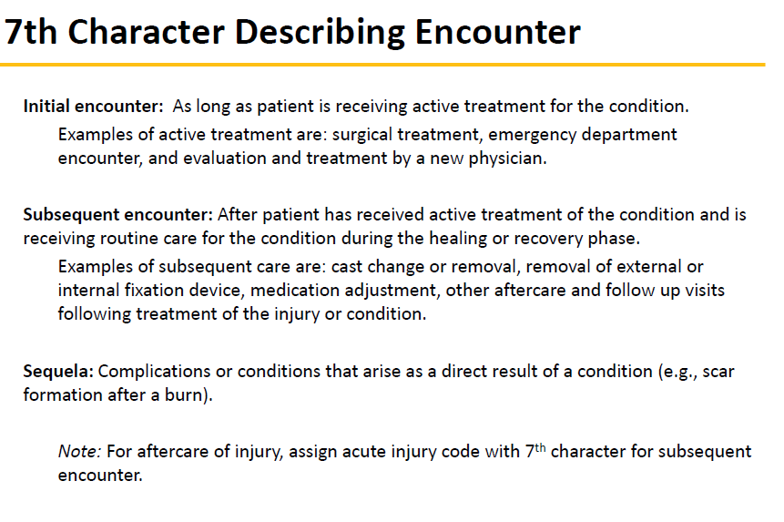

Slide 7
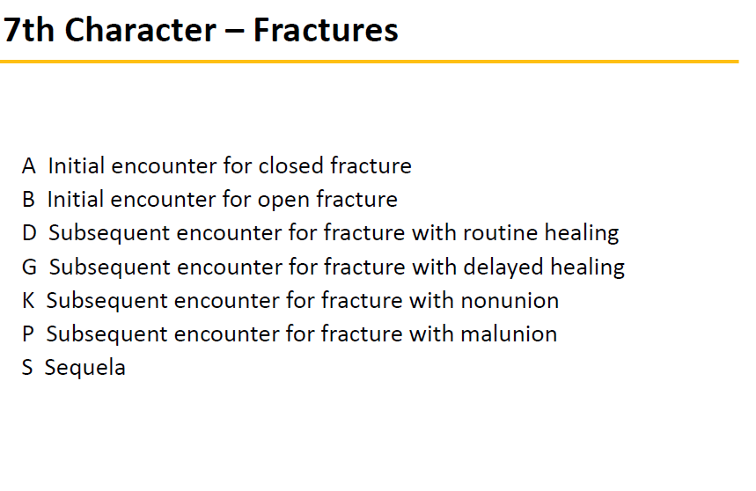

Slide 8
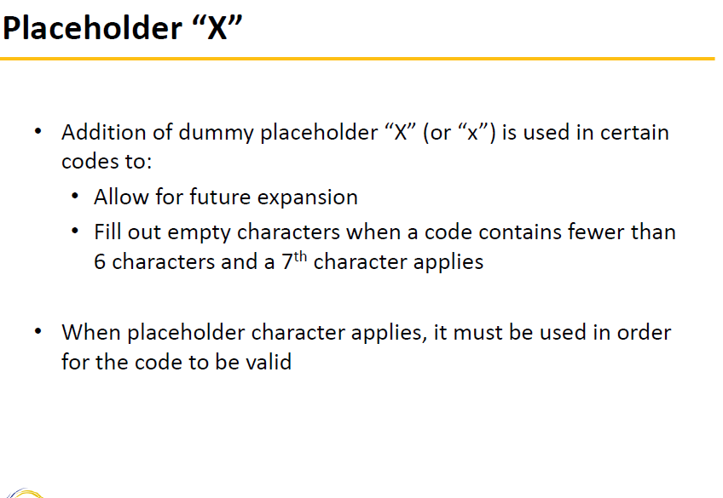

Slide 9
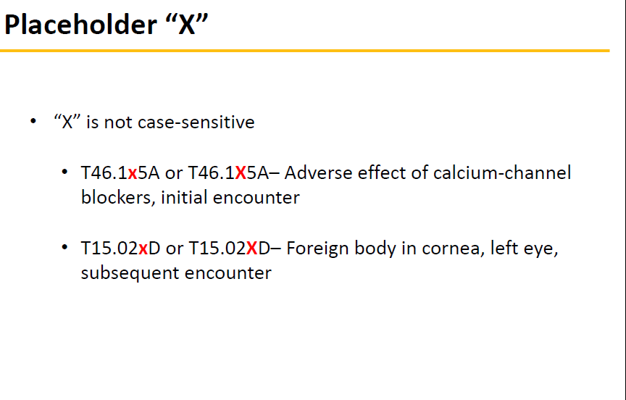

Slide 10
“Placeholder” Example
Some codes are 7 characters, but no 4th, 5th or 6th place is necessary, so “x” is a placeholder
  Example:
T68.xxxA - Hypothermia
The appropriate 7th character is to be added to code T68
A – initial encounter
D – Subsequent encounter
S – sequela

Slide 11
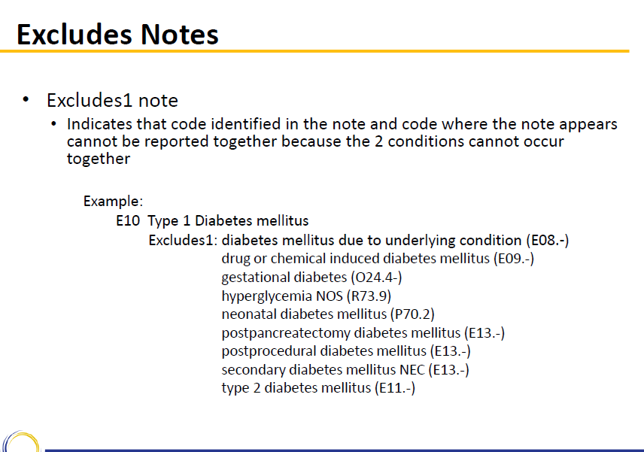

Slide 12
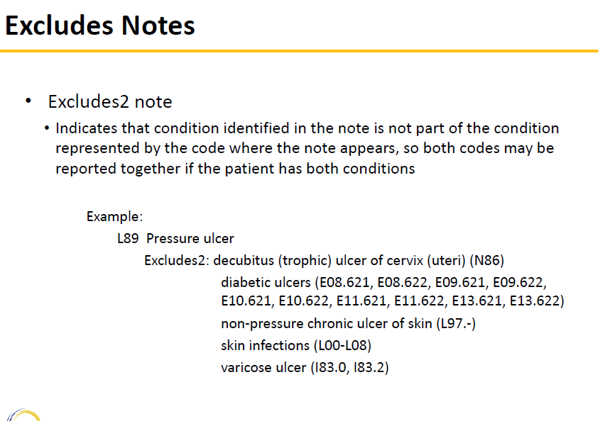

Slide 13
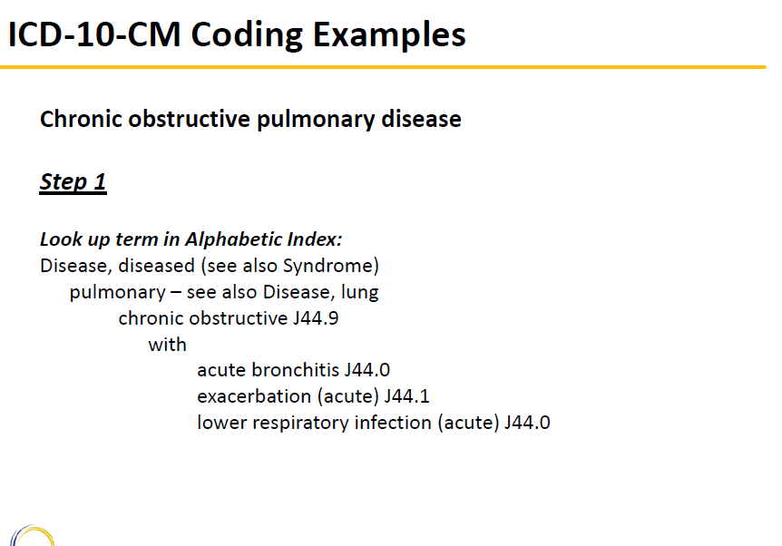

Slide 14
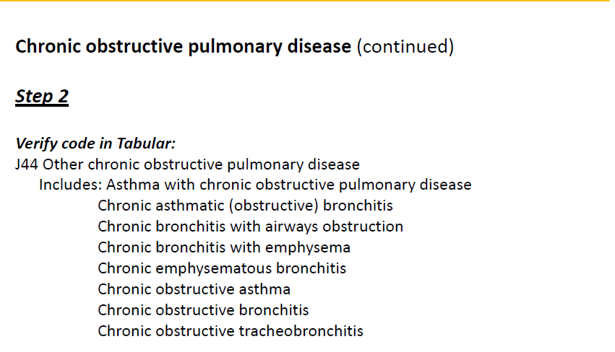

Slide 15
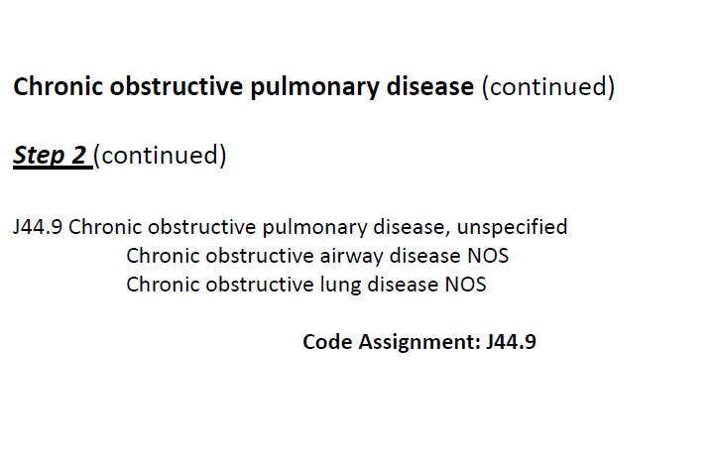

Slide 16
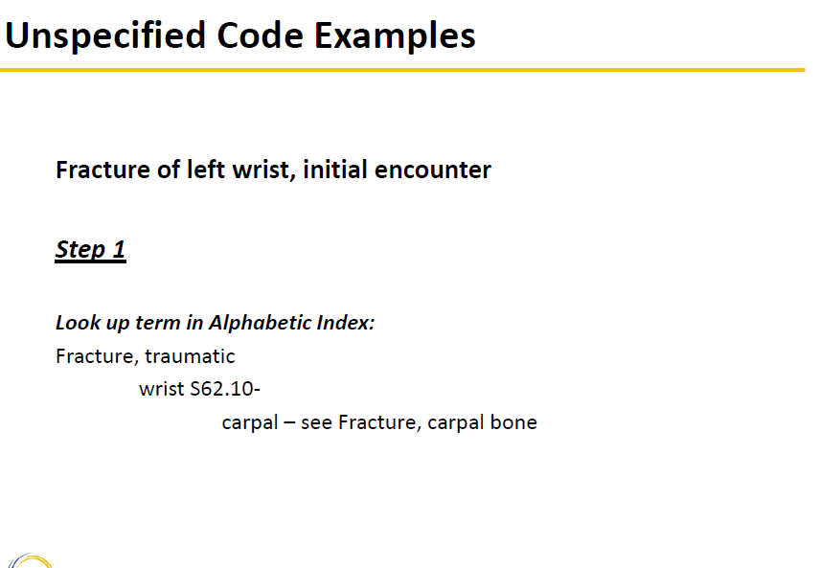

Slide 17
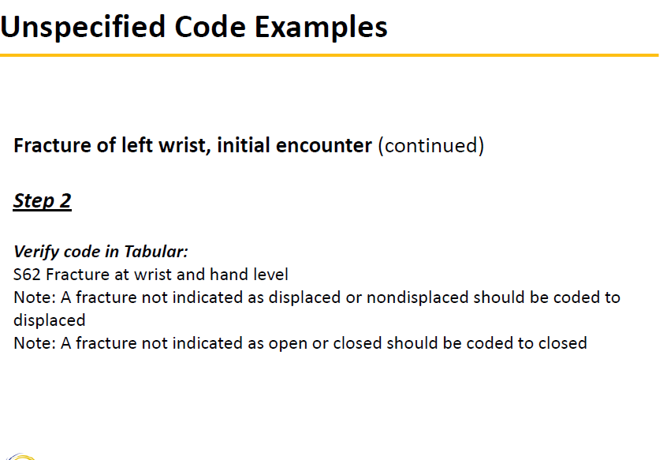

Slide 18
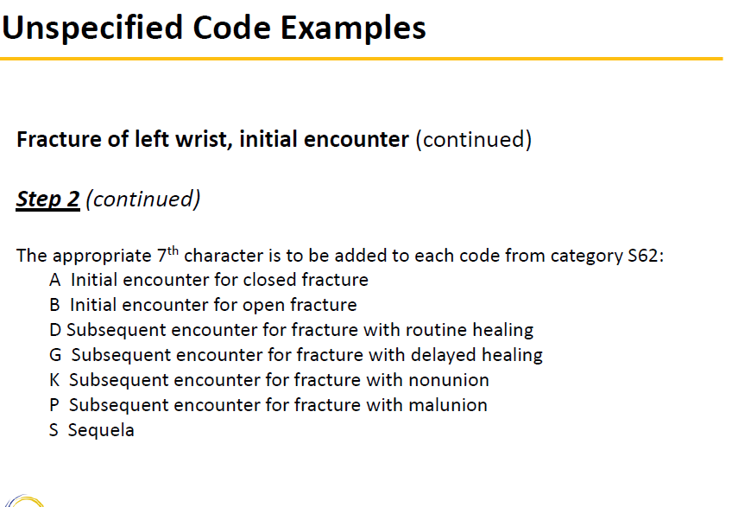

Slide 19
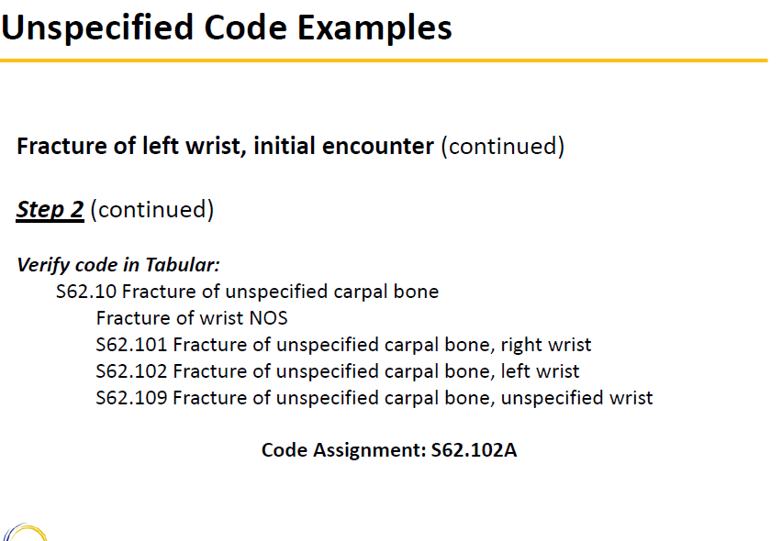

Slide 20
THANK YOU

